Slide 1
Observation Peer Review Assignment Presentation
Janos Kondri

Slide 2
Observation Details
Specialty Coffee Shop (Kitsune Japanese Caffee) located near Nagyvarad Square
Time: 8:30–9:00, weekday
30-minute observation
16 customers total (6 ordered for here, 10 for takeaway)

Slide 3
Players
2 Cashiers – Interacting with customers by taking orders & processing payments
2 Baristas – Interacting with cashiers to prepare orders of customers as well as deliver them
Manager – Manages additional tasks within the business, during rushours performs additional barista role.
Customers – All interact with the cashiers and/or manager to place orders, either takeaway or for here

Slide 4
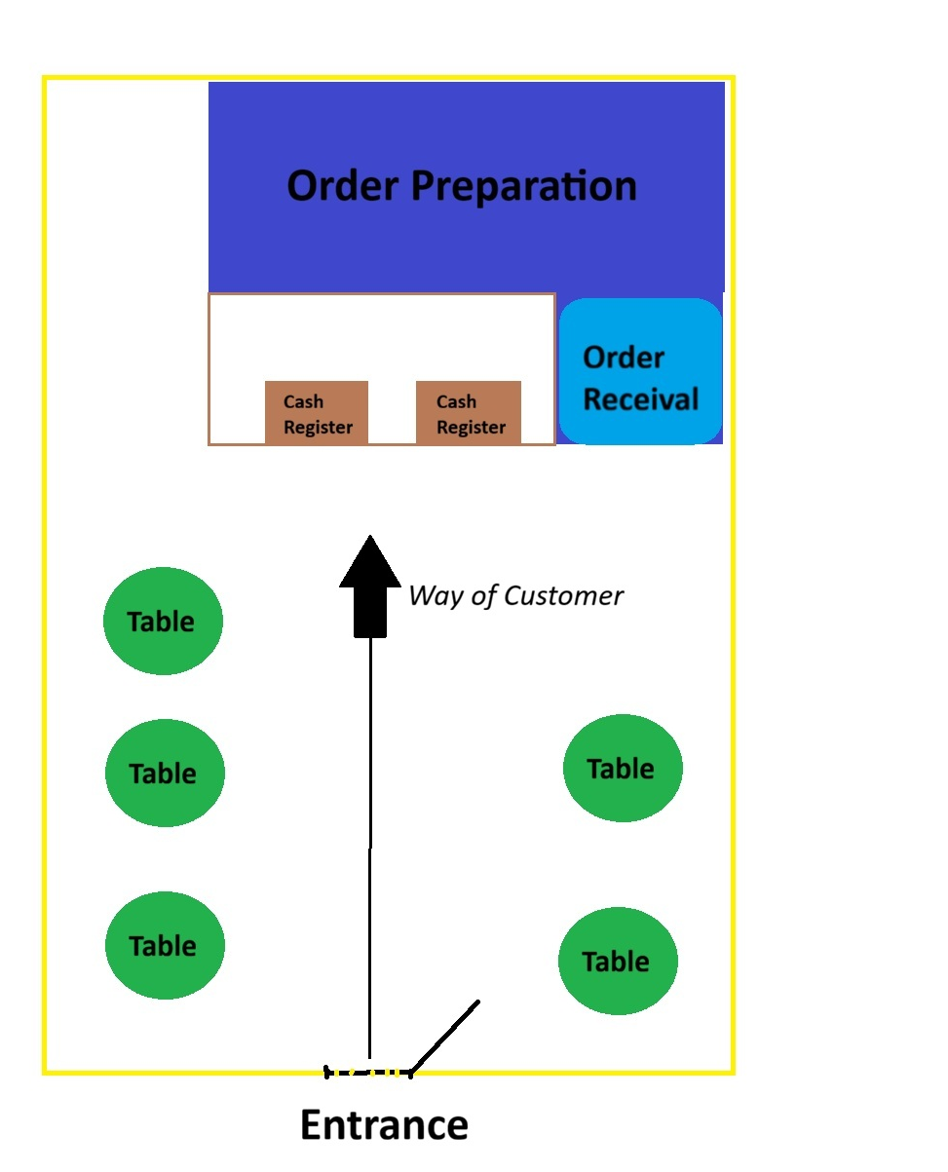
Location Overview

Slide 5
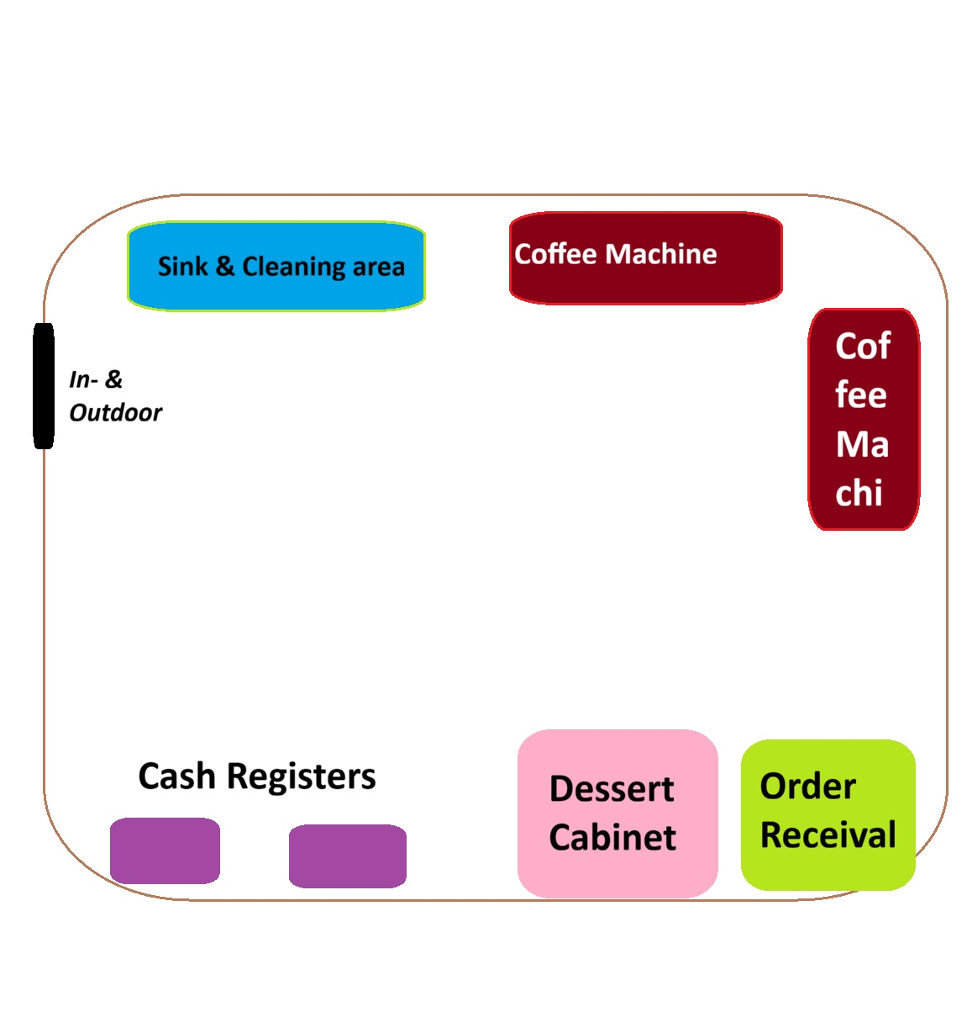
Location Overview

Slide 6
What’s the technology
Computers
Cash registers function all electronically with cash option available. Equipped with contactless card payment
Paper/pencil - > Orders are processed and given to baristas via paper receipts
Coffee machines, grinders, milk frothers
Cooled display cabinet for desserts

Slide 7
Process – Ordering a Drink (1)
1. Customer enters and joins queue
2. Reviews menu board
3. Orders at cashier
Includes choice of coffee, and if order is consumed here or for takeaway
4. Payment processed electronically or by cash

Slide 8
Process – Ordering a Drink (2)
5. Order handed over to barista from cashier via paper receipt
6. Barista grinds coffee, prepares drink
7. Drink placed at pickup counter
8. Customer retrieves drink

Slide 9
Challenges Observed
Queue occasionally blocks seating access
Barista workload spikes from larger queus
Paper-based system can have orders get lost
Customers unsure where pick-up point is sometimes
Limited space behind barista station

Slide 10
Solutions
Better display for customer order receival area
Easier access and handover of orders to customers
Add markings to maintain seating-path clearance
Less commotion between incoming and seated customers
Electronic order handling system
Less confusion and missing orders by eliminating handover of handwritten receipts between baristas and cashiers

Slide 11
Next Research Steps
Use semi-structured interviews with baristas, cashiers, manager
Observe peak vs non-peak workflow differences
Collect customer feedback via brief intercept interviews
Goal: understand workflow bottlenecks and pain points

